Slide 1
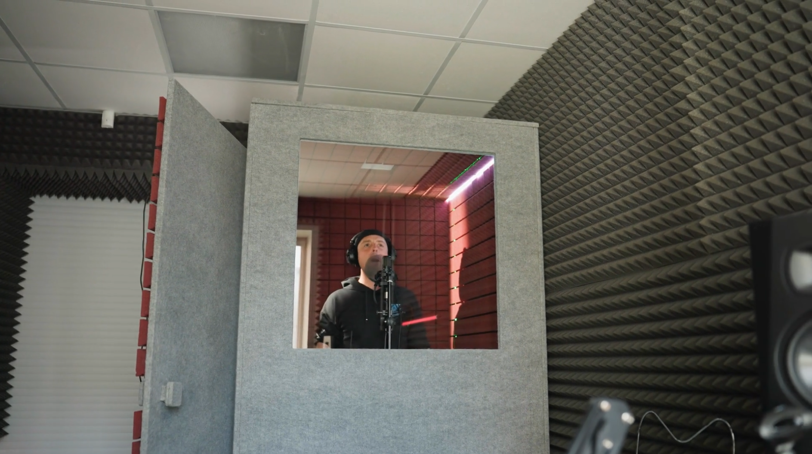
Acoustic Enclosures
Enclosure design details
Tyler Dare

Slide 2
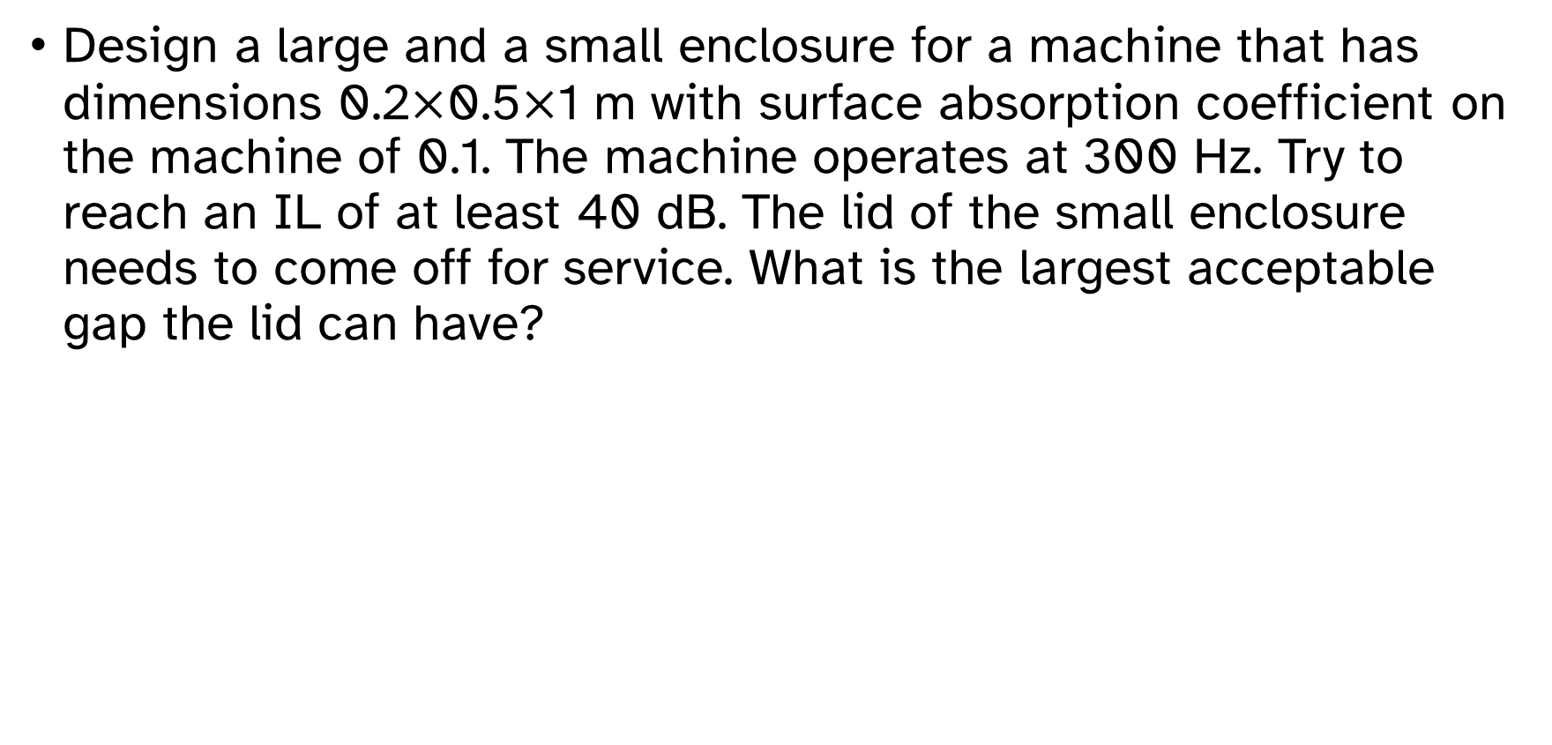
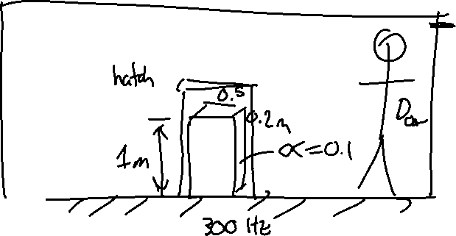
Example: Enclosure with service access
Design a large and a small enclosure for a machine that has dimensions 0.2$×$0.5$×$1 m with surface absorption coefficient on the machine of 0.1. The machine operates at 300 Hz. Try to reach an IL of at least 40 dB. The lid of the small enclosure needs to come off for service. What is the largest acceptable gap the lid can have?

Slide 3

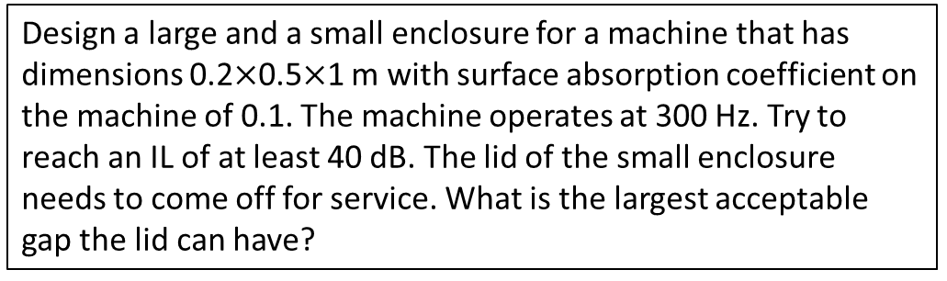
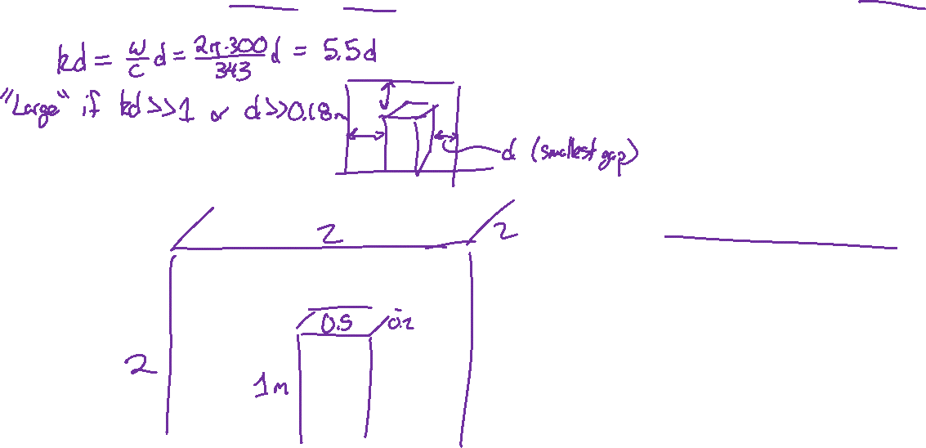
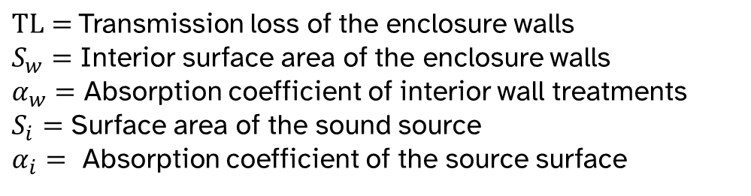
Example: Enclosure with service access
Design a large and a small enclosure for a machine that has dimensions 0.2$×$0.5$×$1 m with surface absorption coefficient on the machine of 0.1. The machine operates at 300 Hz. Try to reach an IL of at least 40 dB. The lid of the small enclosure needs to come off for service. What is the largest acceptable gap the lid can have?
What determines large vs. small enclosure?
Start with large enclosure:
$$IL_{large}=10\log_{10}\left[1+\frac{S_{w}α_{w}+S_{i}α_{i}}{S_{w}+S_{i}} {10}^{\left({TL}/{10}\right)}\right]$$
$TL=$Transmission loss of the enclosure walls
$S_{w}=$ Interior surface area of the enclosure walls
$α_{w}=$ Absorption coefficient of interior wall treatments
$S_{i}=$ Surface area of the sound source
$α_{i}=$ Absorption coefficient of the source surface

Slide 4
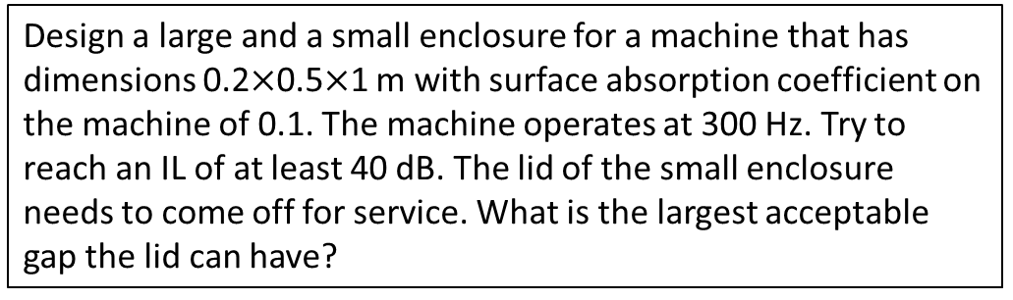
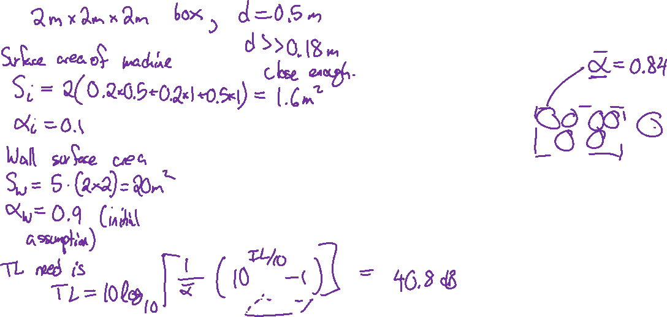
Example: Enclosure with service access
Design a large and a small enclosure for a machine that has dimensions 0.2$×$0.5$×$1 m with surface absorption coefficient on the machine of 0.1. The machine operates at 300 Hz. Try to reach an IL of at least 40 dB. The lid of the small enclosure needs to come off for service. What is the largest acceptable gap the lid can have?
Guess an initial design, iterate if necessary:
$$IL_{large}=10\log_{10}\left[1+\frac{S_{w}α_{w}+S_{i}α_{i}}{S_{w}+S_{i}} {10}^{\left({TL}/{10}\right)}\right]$$
$TL=$Transmission loss of the enclosure walls
$S_{w}=$ Interior surface area of the enclosure walls
$α_{w}=$ Absorption coefficient of interior wall treatments
$S_{i}=$ Surface area of the sound source
$α_{i}=$ Absorption coefficient of the source surface

Slide 5
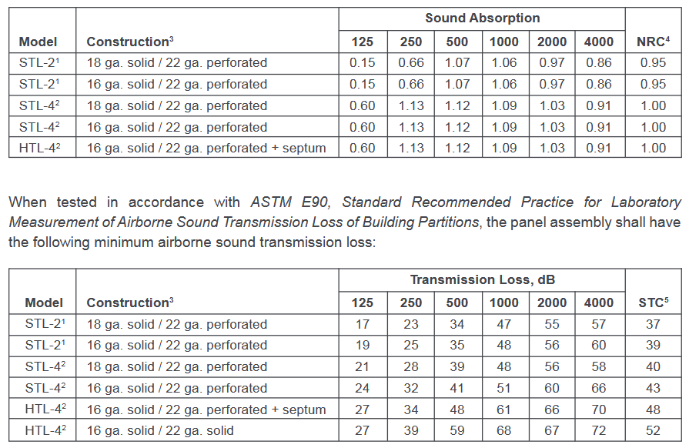
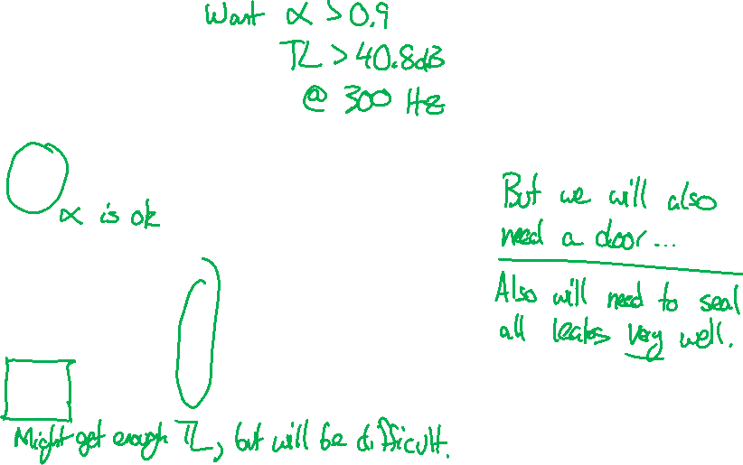
Example: Enclosure with service access
Check commercial products:

Slide 6
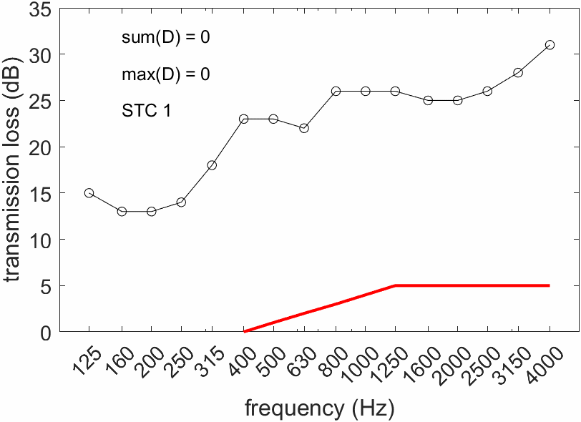
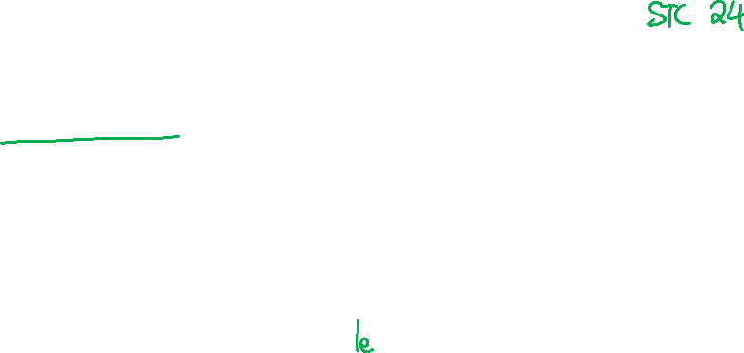
Sound transmission class
Transmission loss is measured according to ASTM E336 and calculated with ASTM E413.
Procedure is standardized and involves measurements of both source and receiver rooms.
Sound transmission class STC is a single-number summary of the transmission loss spectrum.

Slide 7
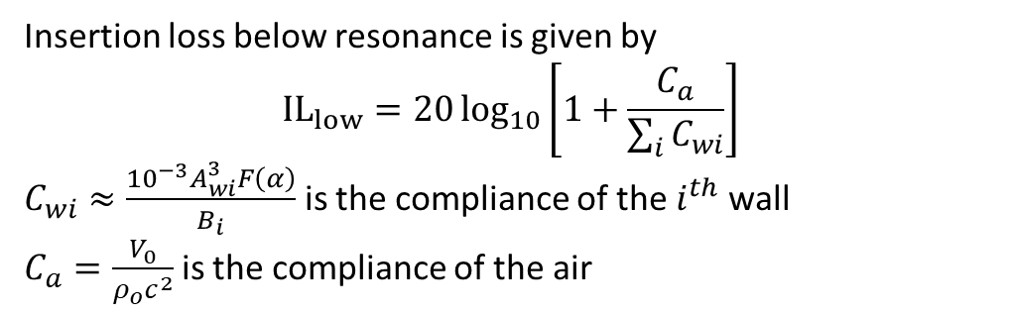
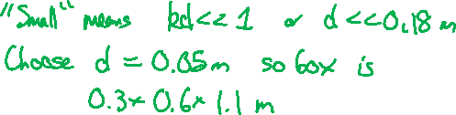
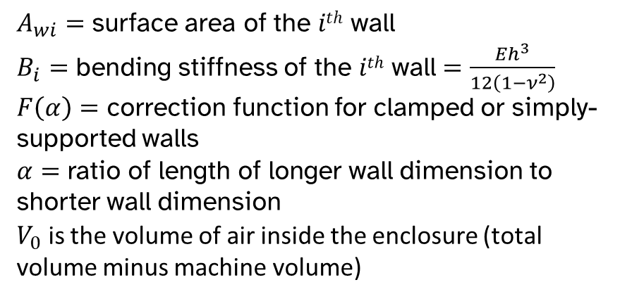
Example: Enclosure with service access
Design a large and a small enclosure for a machine that has dimensions 0.2$×$0.5$×$1 m with surface absorption coefficient on the machine of 0.1. The machine operates at 300 Hz. Try to reach an IL of at least 40 dB. The lid of the small enclosure needs to come off for service. What is the largest acceptable gap the lid can have?
Now consider small enclosure variation:
$A_{wi}=$ surface area of the $ith$ wall
$B_{i}=$ bending stiffness of the $ith$ wall $=\frac{Eh^{3}}{12\left(1−ν^{2}\right)}$
$F\left(α\right)=$ correction function for clamped or simply-supported walls
$α=$ ratio of length of longer wall dimension to shorter wall dimension
$V_{0}$ is the volume of air inside the enclosure (total volume minus machine volume)
Insertion loss below resonance is given by
$${IL}_{low}=20\log_{10}\left[1+\frac{C_{a}}{\sum_{i}{C_{wi}}}\right]$$
$C_{wi}≈\frac{{10}^{−3}A_{wi}^{3}F\left(α\right)}{B_{i}}$ is the compliance of the $i^{th}$ wall
$C_{a}=\frac{V_{0}}{ρ_{o}c^{2}}$ is the compliance of the air

Slide 8
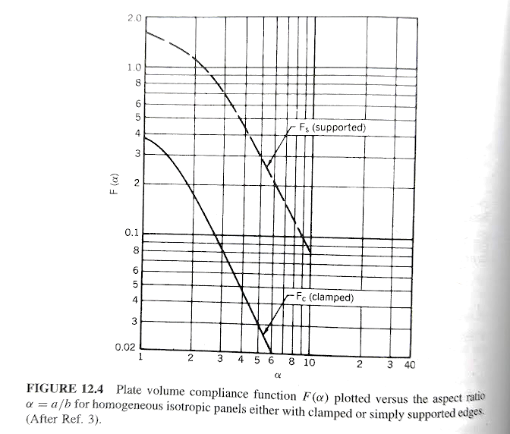
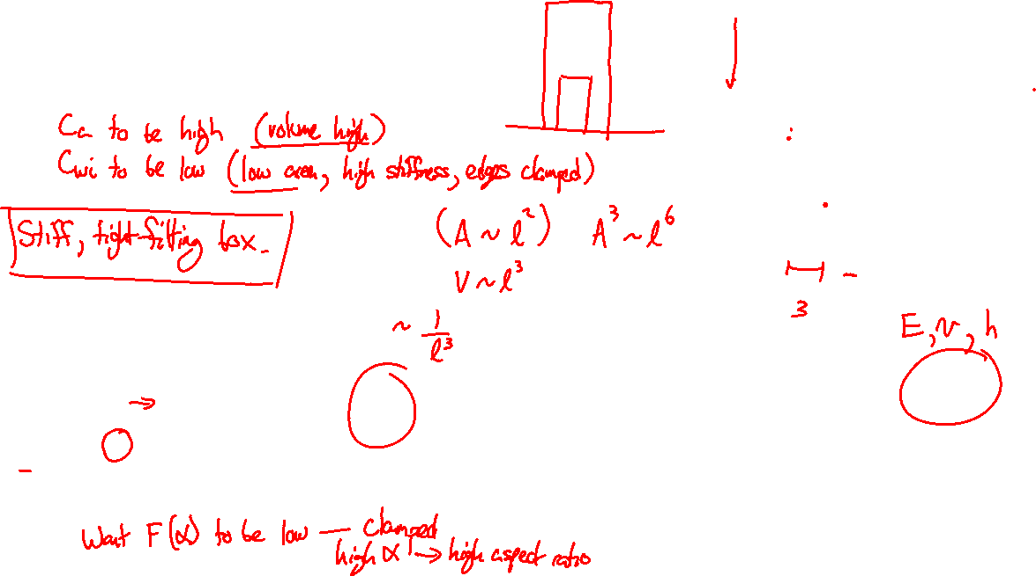
Example: Enclosure with service access
For IL to be high, we want
$A_{wi}=$ surface area of the $ith$ wall
$B_{i}=$ bending stiffness of the $ith$ wall $=\frac{Eh^{3}}{12\left(1−ν^{2}\right)}$
$F\left(α\right)=$ correction function for clamped or simply-supported walls
$α=$ ratio of length of longer wall dimension to shorter wall dimension
$V_{0}$ is the volume of air inside the enclosure (total volume minus machine volume)
Insertion loss below resonance is given by
$${IL}_{low}=20\log_{10}\left[1+\frac{C_{a}}{\sum_{i}{C_{wi}}}\right]$$
$C_{wi}≈\frac{{10}^{−3}A_{wi}^{3}F\left(α\right)}{B_{i}}$ is the compliance of the $i^{th}$ wall
$C_{a}=\frac{V_{0}}{ρ_{o}c^{2}}$ is the compliance of the air

Slide 9
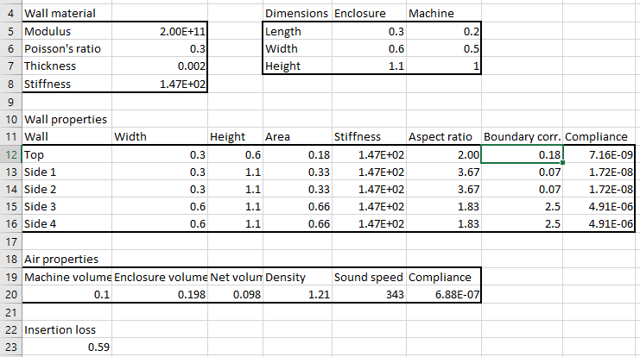
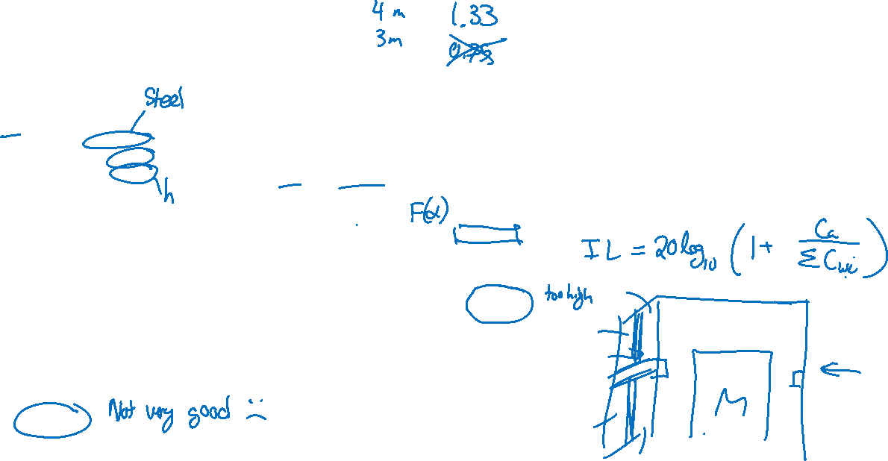
Example: Enclosure with service access
Guess an initial design, iterate if necessary:

Slide 10
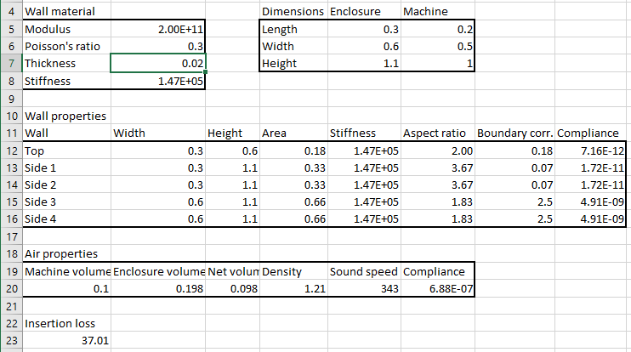
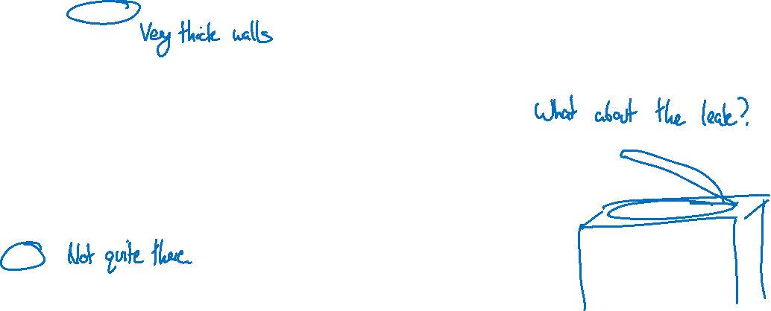
Example: Enclosure with service access
Guess an initial design, iterate if necessary:

Slide 11
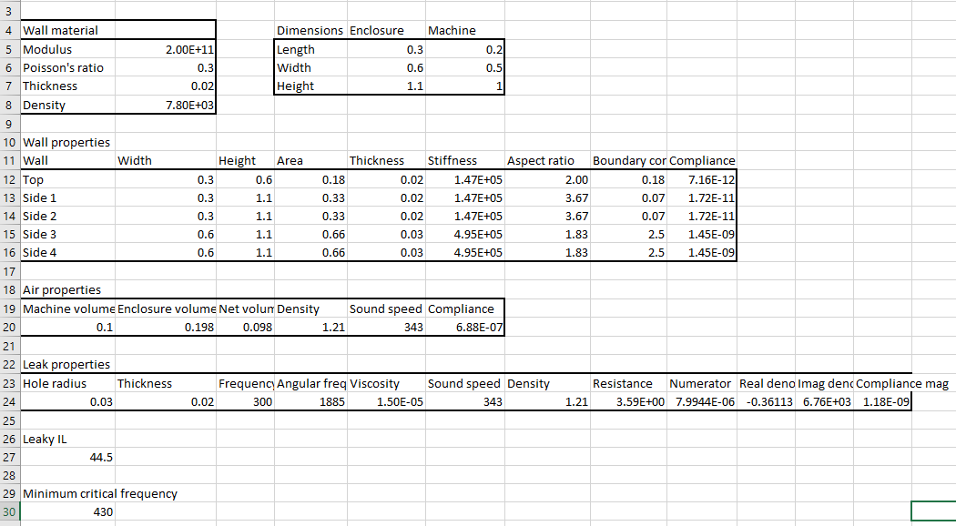
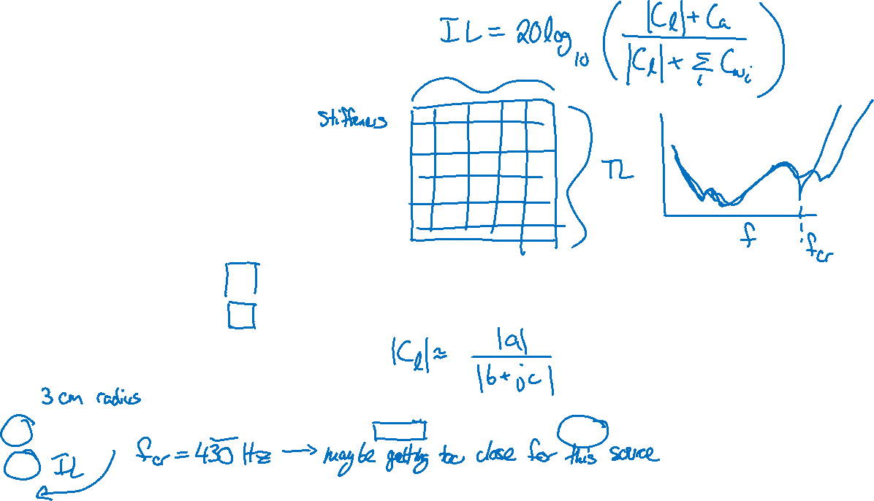
Example: Enclosure with service access
Update design until requirements are met:

Slide 12
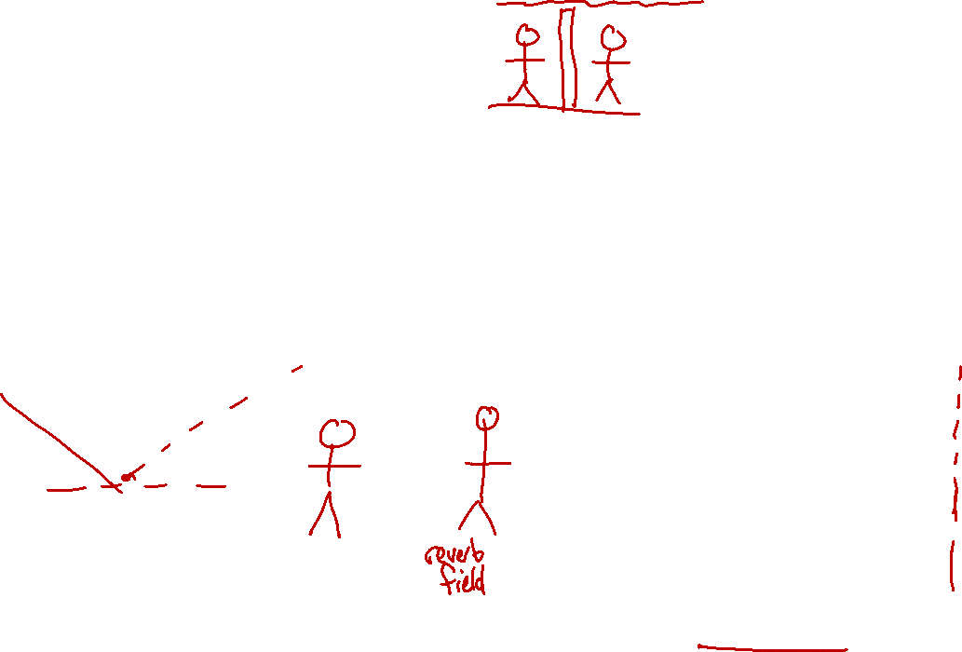
Partial enclosures
Effectiveness of partial enclosure depends heavily on geometry and the directivity of the source.
The effective sound power radiated into the room can be estimated with the leaky enclosure equation. IL greater than 10 dB is difficult without >90% coverage.

Slide 13
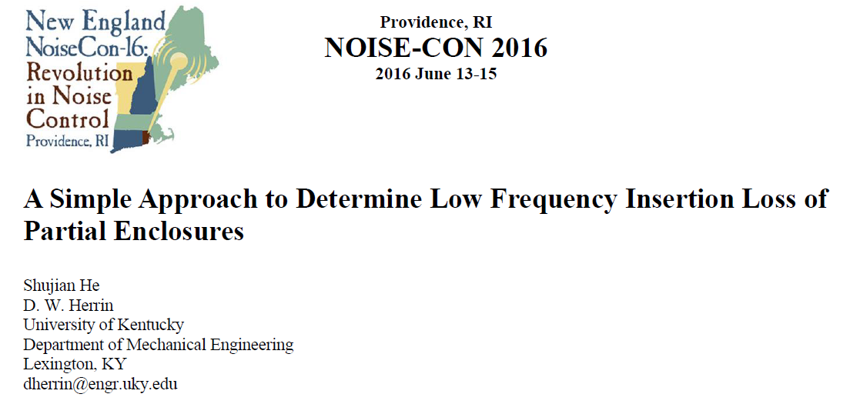
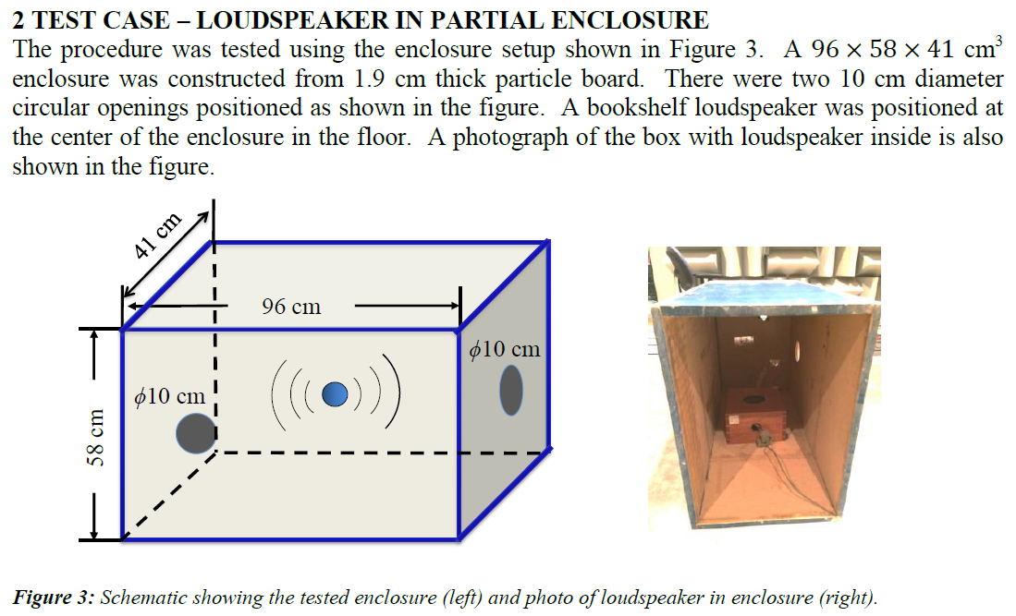
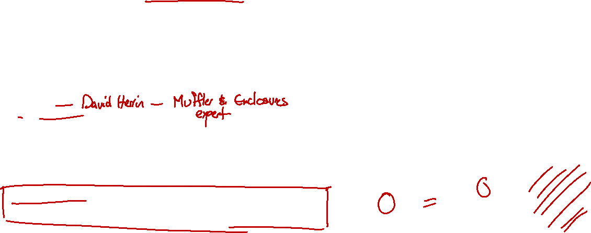
Partial enclosures
“Vér’s equation is rudimentary and based on the percentage of open area and sound absorptive coverage.”

Slide 14
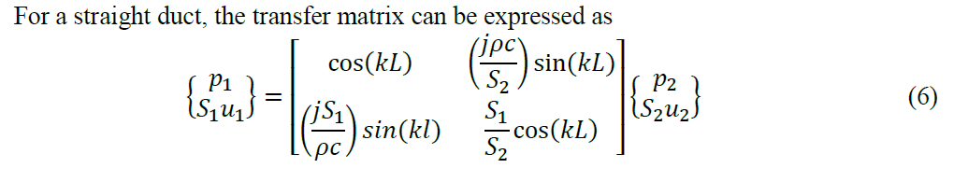
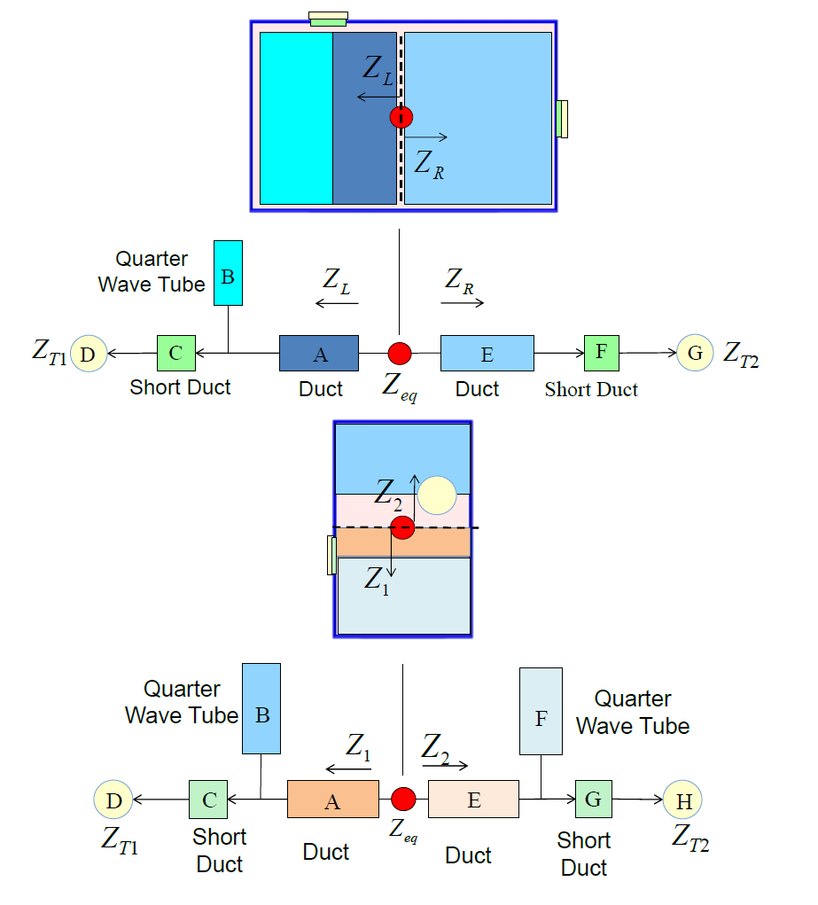
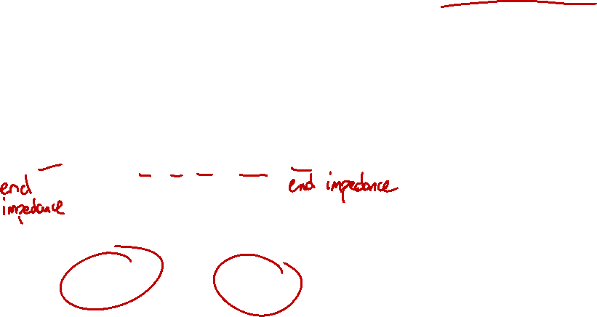
Partial enclosures
He and Herrin model a partial enclosure with duct acoustics equations!

Slide 15
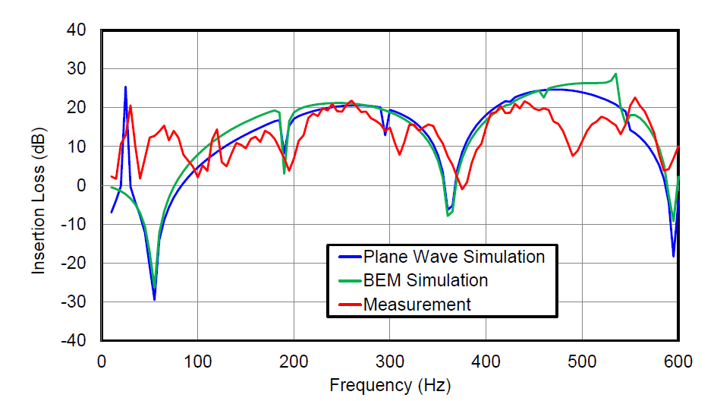
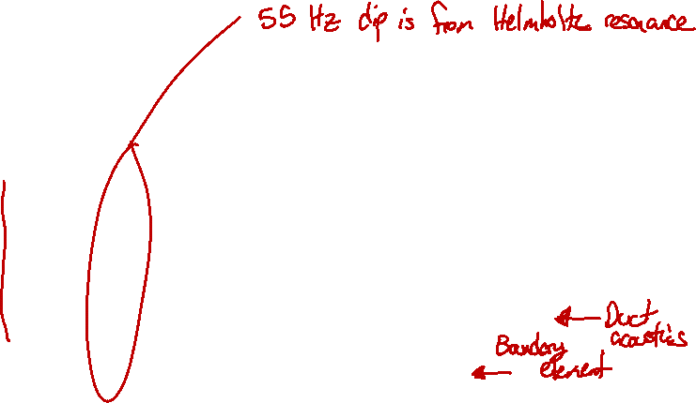
Partial enclosures
Good agreement between measurement and predictions.

Slide 16
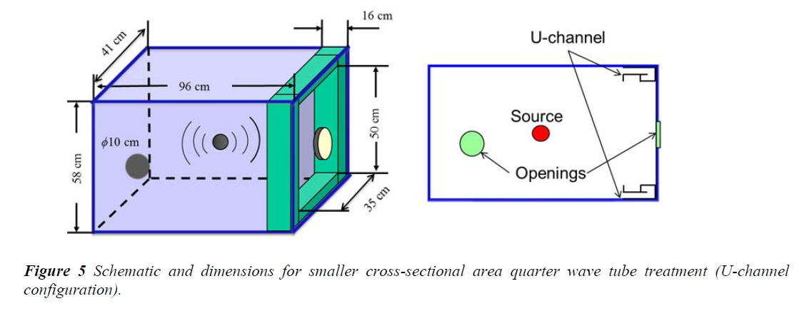
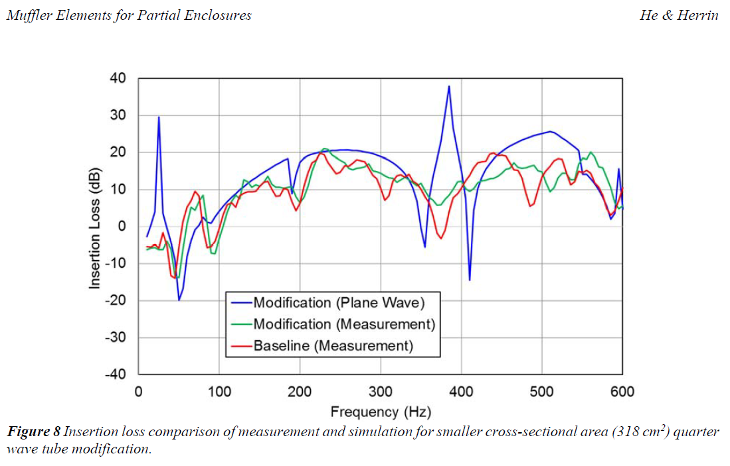
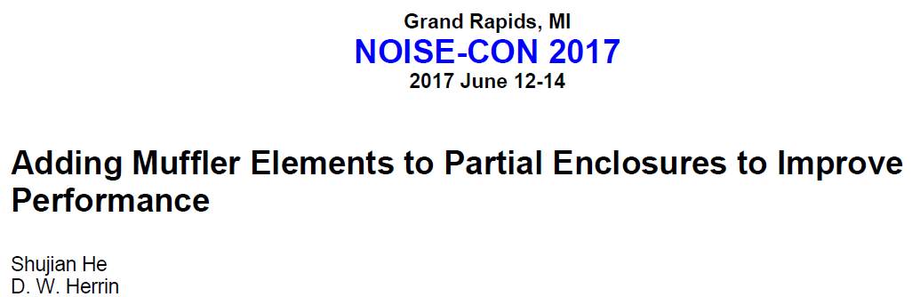
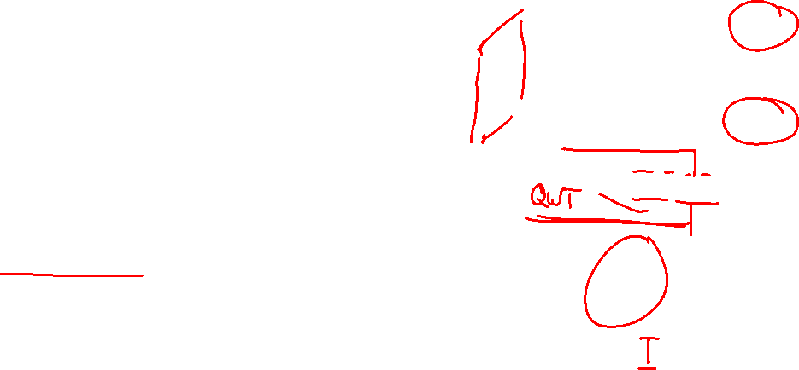
Partial enclosures
One year later, He and Herrin improved the IL by adding a quarter wave tube resonator near one opening.

Slide 17
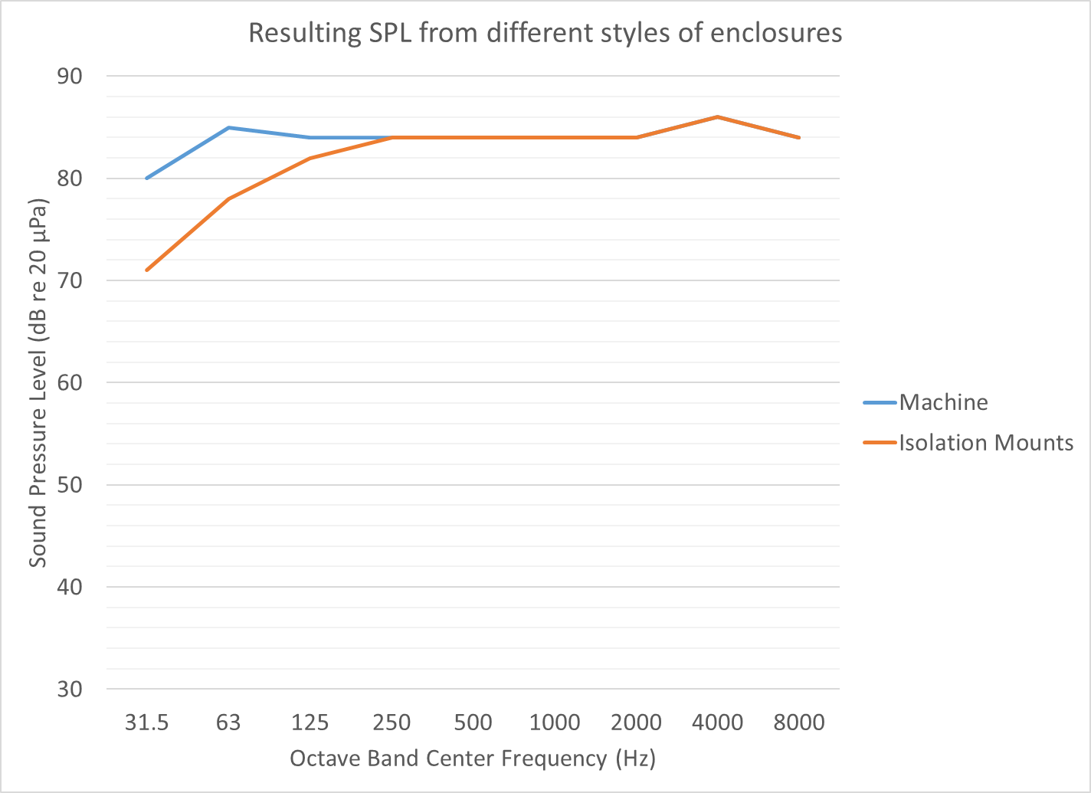
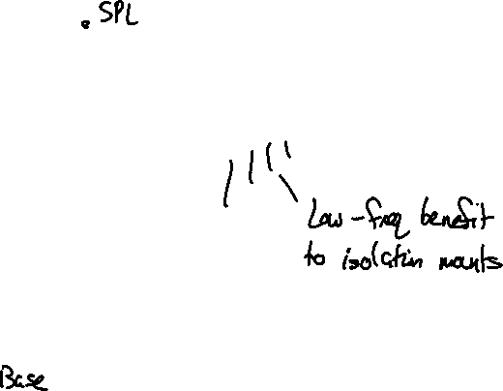
Enclosure isolation can greatly improve performance.
Machine
Isolation Mounts

Slide 18
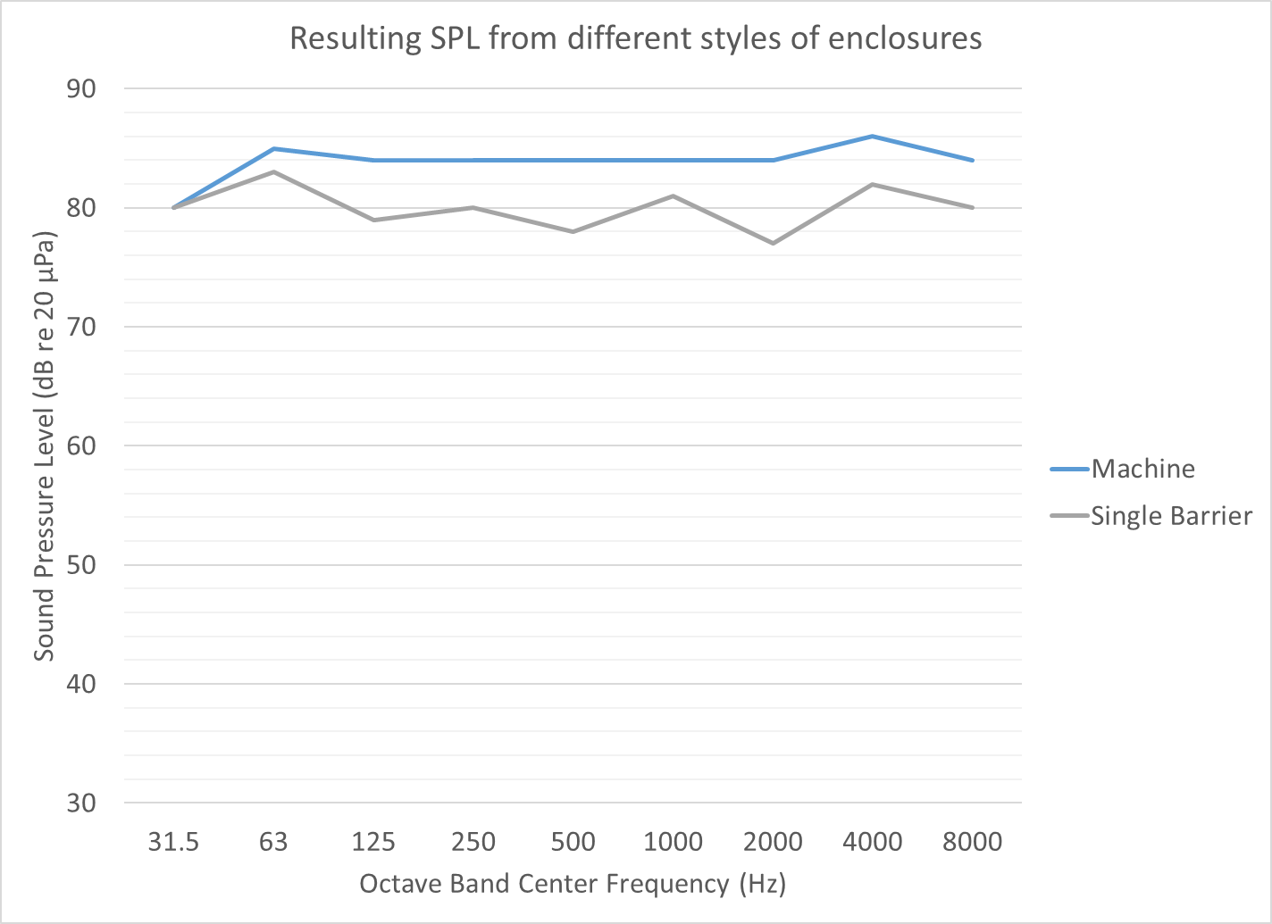
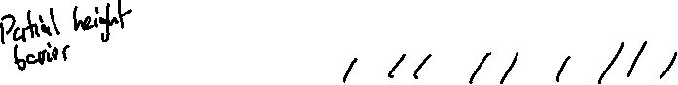
Enclosure isolation can greatly improve performance.
Machine

Slide 19
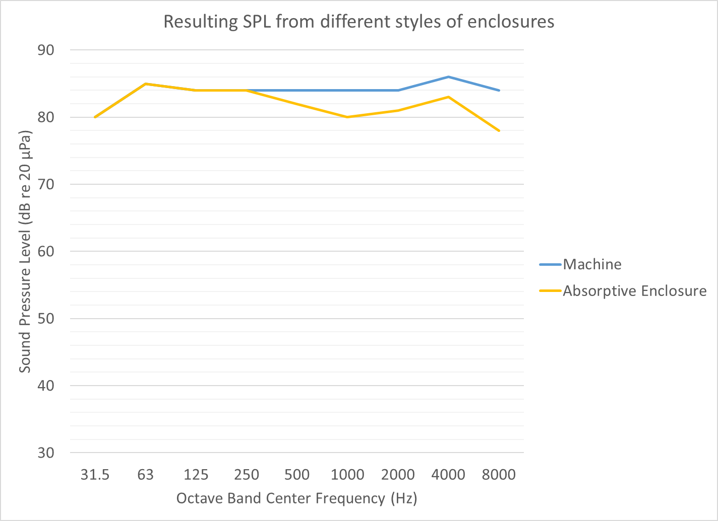
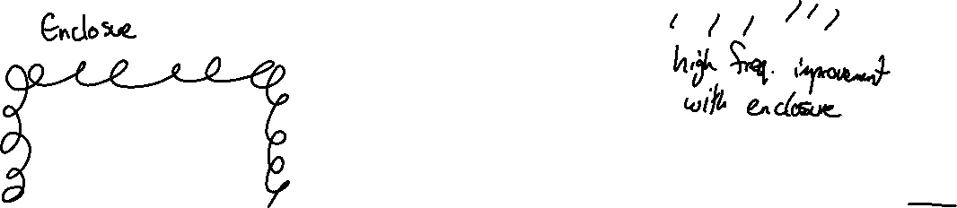
Enclosure isolation can greatly improve performance.
Machine

Slide 20
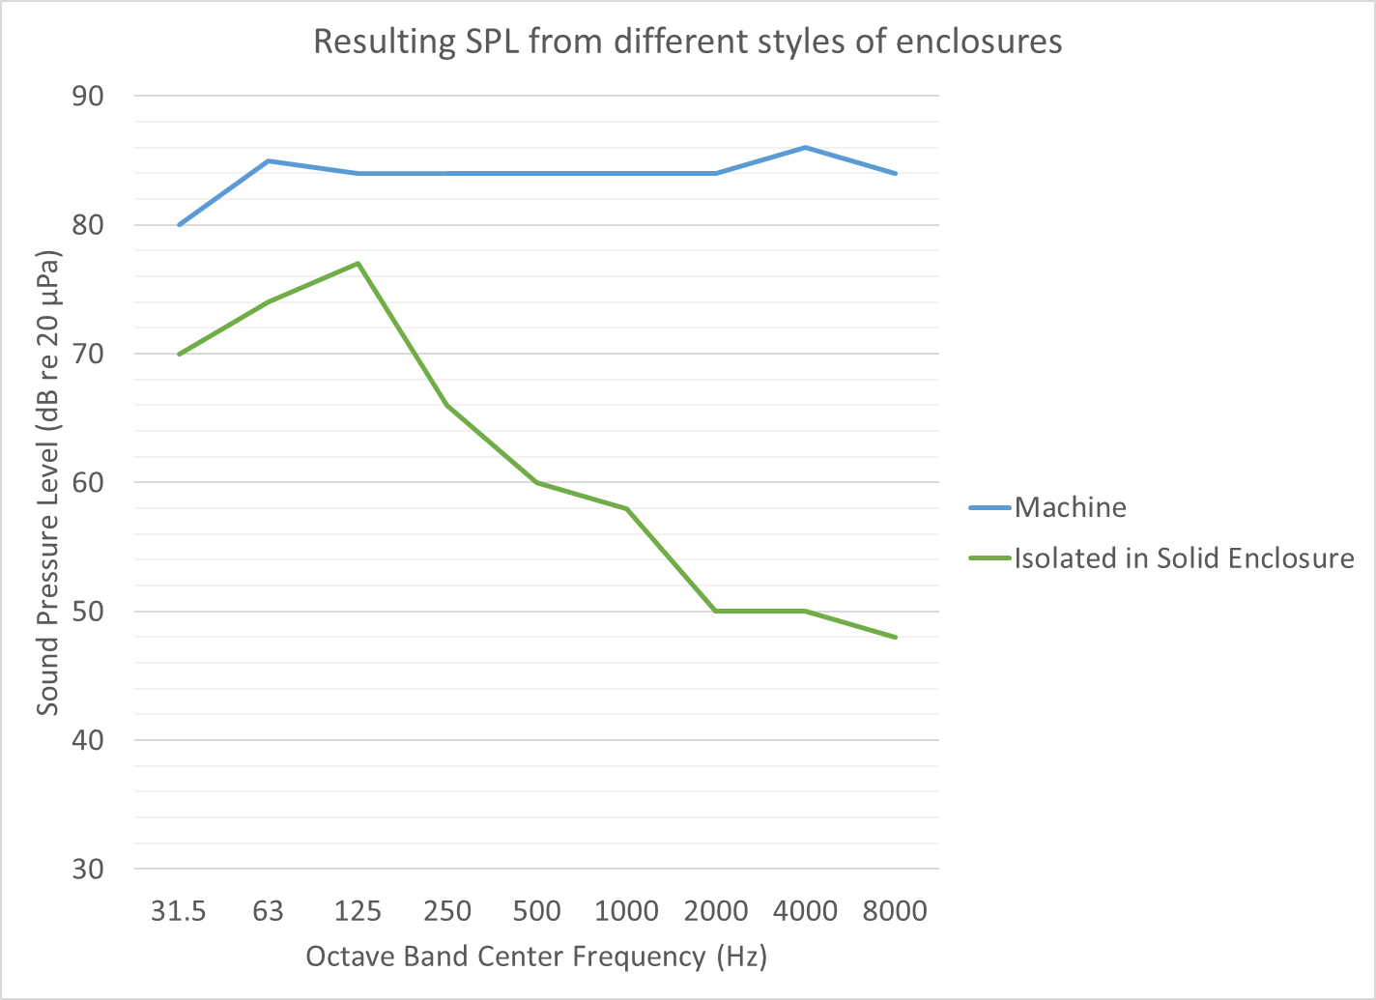
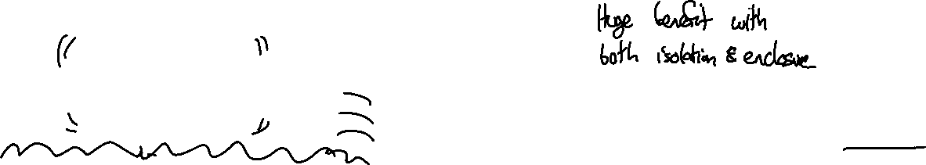
Enclosure isolation can greatly improve performance.
Machine

Slide 21
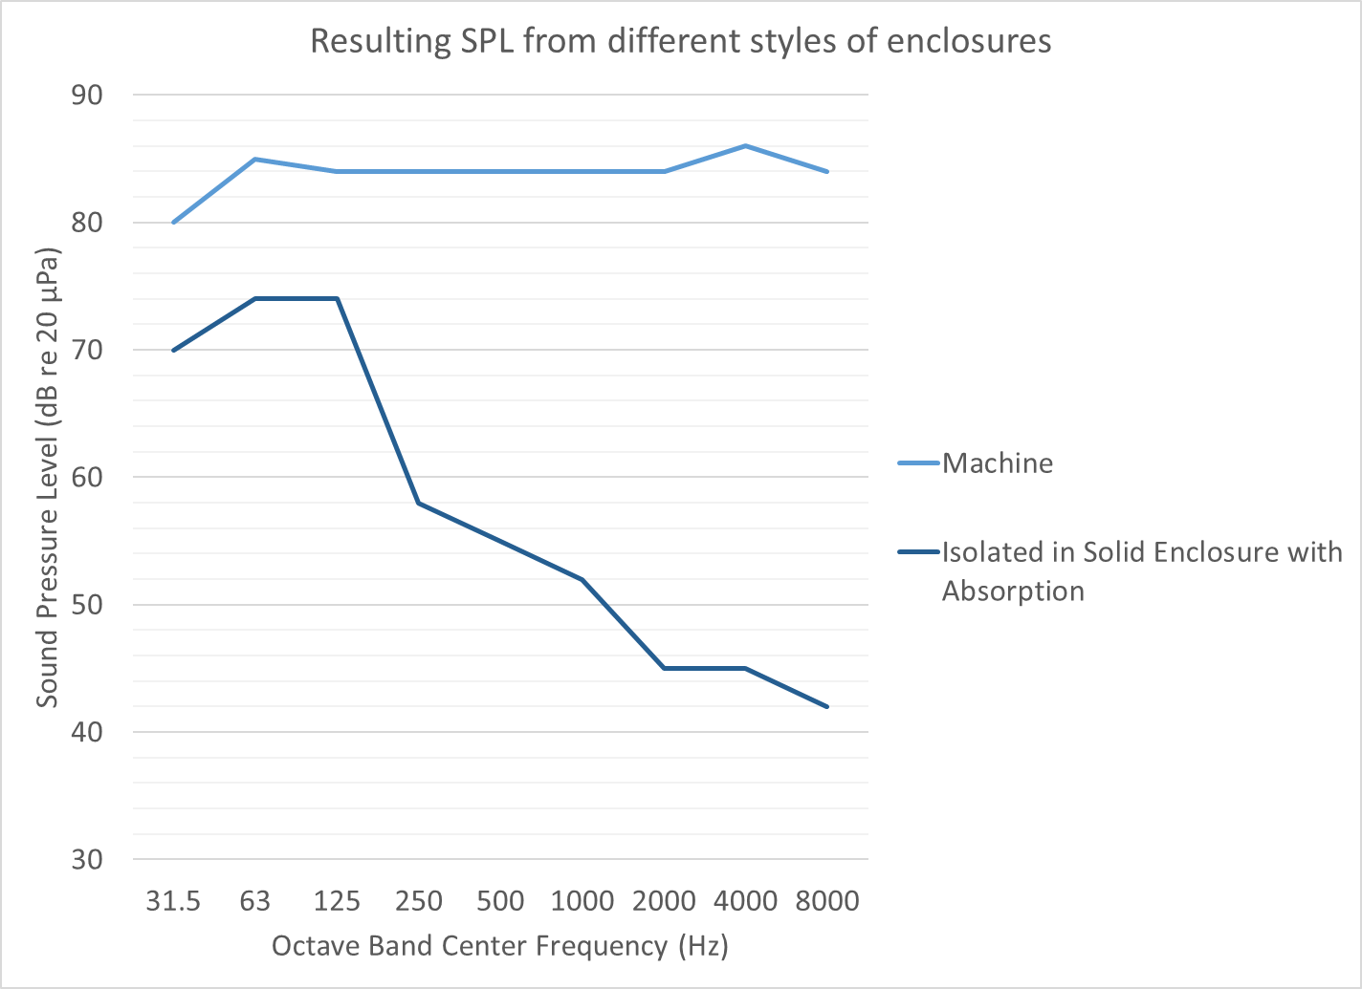
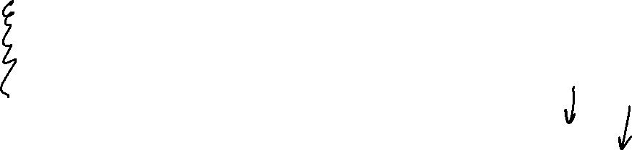
Enclosure isolation can greatly improve performance.
Machine

Slide 22
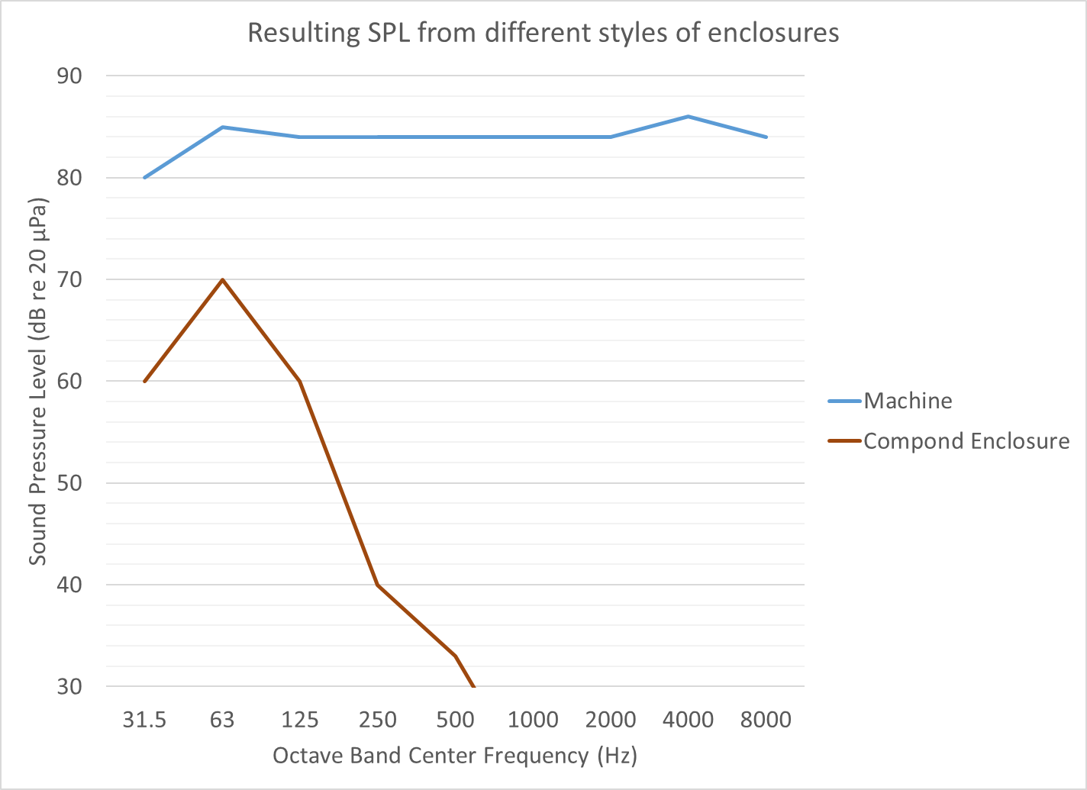

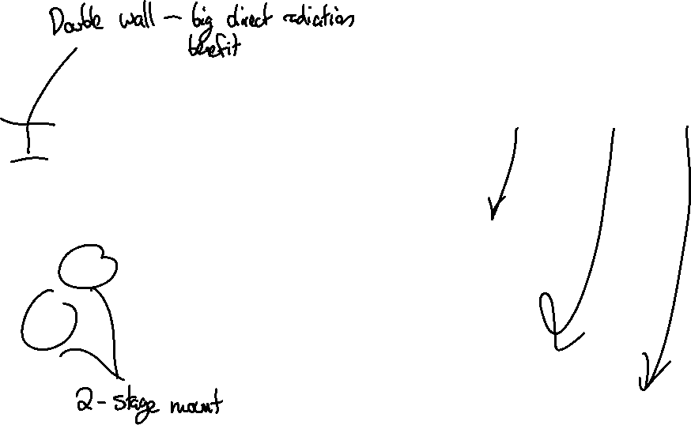
Enclosure isolation can greatly improve performance.
Machine

